Slide 1
NORMALIZATION
Normalization is a database design technique that organizes tables in a manner that reduces redundancy and dependency of data. Normalization divides larger tables into smaller tables and links them using relationships. The purpose of Normalization is to eliminate redundant (useless) data and ensure data is stored logically.

Slide 2

BENEFITS OF NORMALIZATION
improved data integrity (no redundant data)
smaller databases
better performance
fewer indexes
less management
prevents data modification anomalies

Slide 3
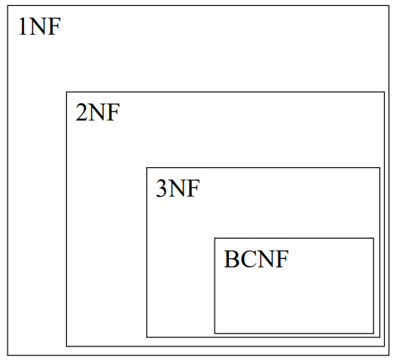
NORMALIZATION
There is a sequence to normal forms:
1NF is considered the weakest,
2NF is stronger than 1NF, 3NF is stronger than 2NF, and
BCNF is considered the strongest
Also,
any relation that is in BCNF, is in 3NF;
any relation in 3NF is in 2NF; and any relation in 2NF is in 1NF.

Slide 4
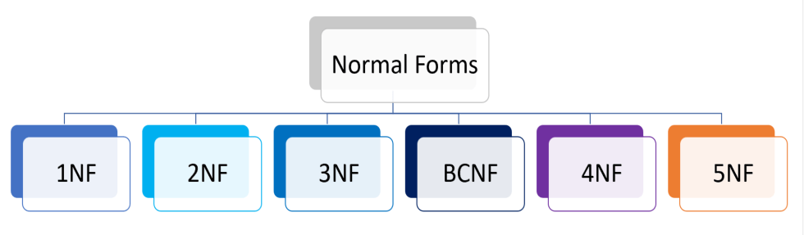
TYPES OF NORMALIZATION

Slide 5
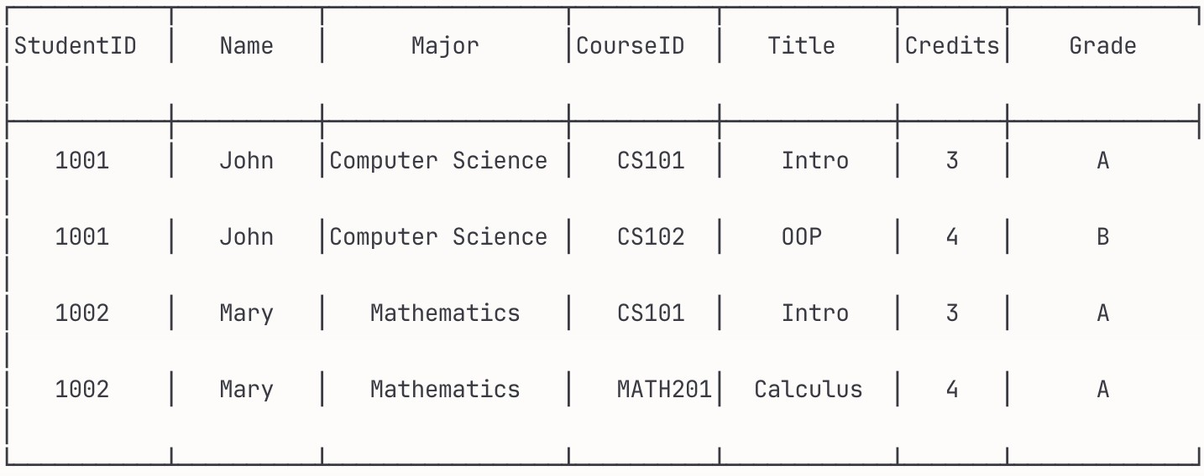
Normalization - Why Do We Need It?
Problems with Unnormalized Tables:
Example: StudentCourseInfo Table
Problems:
Redundancy: John's info repeated for each course
Update Anomaly: Change John's major → update multiple rows
Insert Anomaly: Can't add new student without enrollment
Delete Anomaly: Delete last enrollment → lose student info

Slide 6


First Normal Form (1NF)
Rule: All attributes must contain atomic (indivisible) values
Violation Examples:
Multi-valued Attributes:
Student(ID, Name, PhoneNumbers, Skills) (1, "John", "555-1234, 555-5678",
"Java, Python, SQL")
Composite Attributes:
Employee(ID, Name, Address, Department)
(101, "Alice", "123 Main St, Boston, MA 02101", "CS")
1NF Solutions:
Separate Multi-valued:
Student(ID, Name) StudentPhone(StudentID, PhoneNumber) StudentSkill(StudentID, Skill)
Break Composite:
Employee(ID, Name, Street, City, State, Zip, Department)

Slide 7
Second Normal Form (2NF)
Rule: Must be in 1NF + No partial dependencies
Partial Dependency: Non-key attribute depends on part of composite primary key
Violation Example:
2NF Solution:
Enrollment(StudentID, CourseID,
StudentName, CourseName, Grade)
Primary Key: (StudentID, CourseID)
Student(StudentID, StudentName)
Course(CourseID, CourseName) Enrollment(StudentID, CourseID, Grade)
Partial Dependencies:
-
-
-
StudentName depends only on StudentID
CourseName depends only on CourseID Grade depends on full key ✓
Key Point: If primary key is single attribute, you automatically satisfy 2NF!

Slide 8
Third Normal Form (3NF)
Rule: Must be in 2NF + No transitive dependencies
Transitive Dependency: A → B → C (where A is key, C is non-prime)
Violation Example:
3NF Solution:
Employee(EmpID, Name, Department, DeptHead, DeptBudget)
Dependencies:
EmpID → Department (direct dependency
✓)
Department → DeptHead (transitive dependency )
Department → DeptBudget (transitive dependency )
Chain: EmpID → Department → DeptHead
Employee(EmpID, Name, Department) Department(Department, DeptHead, DeptBudget)
Another Example:
Order(OrderID, CustomerID, CustomerName, CustomerCity)
OrderID → CustomerID → CustomerName OrderID → CustomerID → CustomerCity
Order(OrderID, CustomerID) Customer(CustomerID, CustomerName, CustomerCity)

Slide 9
Boyce-Codd Normal Form (BCNF)
Rule: For every functional dependency A → B, A must be a superkey
When 3NF ≠ BCNF: Overlapping candidate keys
StudentAdvisor(StudentID, Major, Advisor)
Business Rules:
-
-
-
Each student has one major
Each advisor works in only one major -
Students can have multiple advisors in their major
BCNF Solution:
StudentMajor(StudentID, Major) AdvisorMajor(Advisor, Major) StudentAdvisor(StudentID, Advisor)
Functional Dependencies:
-
-
-
(StudentID, Advisor) → Major
(StudentID, Major) → Advisor
Advisor → Major ← This violates BCNF!
Candidate Keys: {StudentID, Advisor}, {StudentID, Major}

Slide 10

First Normal Form
We say a relation is in 1NF if all values stored in the relation are single-valued and atomic. 1NF places restrictions on the structure of relations. Values must be simple.
The following is not in 1NF:
Name | Birth_date | Certifications | Certification 1 | Certification 2 | Certification 3
John | 1990/02/12 | PBI, MCSA, MTA | PBI | MCSA | MTA
Kelly | 1988/10/01 | Excel | Excel | NULL | NULL
Bryan | 1991/01/15 | PBI, Excel | PBI | Excel | NULL
Rob | 1986/08/07 | PBI | PBI | NULL | NULL
To obtain 1NF relations we must, without loss of information, eliminate repeating groups of data or repeating columns + primary key.

Slide 11

First Normal Form
We say a relation is in 1NF if all values stored in the relation are single-valued and atomic. 1NF places restrictions on the structure of relations. Values must be simple.
Learner _ID | Name | Birth_date | Certification _ID | Certification _name | Vendor_ name | Date_acquir ed
1 | John | 1990/02/12 | 1 | PBI | Microsoft | 2017/01/08
1 | John | 1990/02/12 | 2 | MCSA | Microsoft | 2020/04/16
1 | John | 1990/02/12 | 3 | MTA | Microsoft | 2021/05/12
2 | Kelly | 1988/10/01 | 4 | Excel | Microsoft | 2018/06/03
3 | Bryan | 1991/01/15 | 1 | PBI | Microsoft | 2019/12/11
3 | Bryan | 1991/01/15 | 4 | Excel | Microsoft | 2020/04/07
4 | Rob | 1986/08/07 | 1 | PBI | Microsoft | 2022/01/15

Slide 12

Second Normal Form
Note: If PK is set as a single then you don't need to do anything, the table is already in 2NF
A relation will be in 2NF if it is in 1NF.
All non-key attributes are fully functional dependent on the primary key.
Create separate tables for sets of values that apply to multiple records.
Relate these tables with a foreign key.
Learner_ID | Name | Birth_date
1 | John | 1990/02/12
2 | Kelly | 1988/10/01
3 | Bryan | 1991/01/15
4 | Rob | 1986/08/07
Learner_ID | Certification_ID | Date_acquired
1 | 1 | 2017/01/08
1 | 2 | 2020/04/16
1 | 3 | 2021/05/12
2 | 4 | 2018/06/03
3 | 1 | 2019/12/11
3 | 4 | 2020/04/07
4 | 1 | 2022/01/15
Certification _ID | Certification _name | Vendor_ name
1 | PBI | Microsoft
2 | MCSA | Microsoft
3 | MTA | Microsoft
4 | Excel | Microsoft

Slide 13

Third Normal Form
3NF satisfy all conditions of 2NF
A relation in 3NF will not have any transitive dependencies of non-key attributes on key column must be removed.
Vendor_ID | Vendor_name
1 | Microsoft
2 | Amazon
Certification _ID | Certification _name | Vendor_ name
1 | PBI | Microsoft
2 | MCSA | Microsoft
3 | MTA | Microsoft
4 | Excel | Microsoft
Certification _ID | Certification _name | Vendor_I D
1 | PBI | 1
2 | MCSA | 1
3 | MTA | 1
4 | Excel | 1

Slide 15

Third Normal Form
Learner_ID | Name | Birth_date
1 | John | 1990/02/12
2 | Kelly | 1988/10/01
3 | Bryan | 1991/01/15
4 | Rob | 1986/08/07
Learner_ID | Certification_ID | Date_acquired
1 | 1 | 2017/01/08
1 | 2 | 2020/04/16
1 | 3 | 2021/05/12
2 | 4 | 2018/06/03
3 | 1 | 2019/12/11
3 | 4 | 2020/04/07
4 | 1 | 2022/01/15
Certification _ID | Certification _name | Vendor_I D
1 | PBI | 1
2 | MCSA | 1
3 | MTA | 1
4 | Excel | 1
Vendor_ID | Vendor_name
1 | Microsoft
2 | Amazon

Slide 16
SQL – Part 1
Data Definition Language foundation, overview of DDL basic principles

Slide 17
Relations, Entities and Tables
The terminology changes from the Relational Model
through to SQL, but usually means the same thing

Slide 18
Relations, Entities and Tables
The terminology changes from the Relational Model
through to SQL, but usually means the same thing
Relations
E/R Diagrams
SQL
Relation | Entity | Table
Tuple | Instance | Row
Attribute | Attribute | Column or Field
Foreign Key | 1:N Relationship | Foreign Key
Primary Key | Attribute | Primary Key

Slide 19
Implementing E/R Diagrams
Given an E/R design
Name
Address
The entities become SQL tables
Attributes of an entity become columns in the corresponding table
We can approximate the domains of the attributes by assigning types to each column
Relationships may be represented by foreign keys
ID
Student
Year
Has
ID
Enrolment
Code
In
Code
Module
Credits
Title

Slide 20
CREATE DATABASE
First, we need to create a database
CREATE DATABASE database-name;

Slide 21
CREATE TABLE
table-name (
col-def-1,
col-def-2,
CREATE TABLE
col-name-1 col-name-2
You supply
  A name for the table
  A name and definition / type for each column
  A list of constraints
(e.g. Keys)
:
col-name-n col-def-n, constraint-1,
:
constraint-k
);

Slide 22
Column Definitions
col-name
[NULL |
col-def
NOT NULL]
Each column has a
name and a type
Most of the rest of the column definition is optional
There’s more you can add, like storage and index instructions
[DEFAULT
default_value]
[NOT NULL | NULL] [AUTO_INCREMENT] [UNIQUE [KEY] | [PRIMARY KEY]
([] optional, | or)

Slide 23
Types
There are many types in PostgreSQL, but most are variations of the standard types
Numeric Types
  TINYINT, SMALLINT, INT, MEDIUMINT, BIGINT
  FLOAT, REAL, DOUBLE, DECIMAL
Dates and Times
  DATE, TIME, YEAR
Strings
  CHAR, VARCHAR
Others
  ENUM, BLOB

Slide 24
Types
We will use a small subset of the possible
types:
Type Description Example
TINYINT | 8 bit integer | -128 to 127
INT | 32 bit integer | -2147483648 to 2147483647
CHAR (m) | String of fixed length m | “Hello World ”
VARCHAR (m) | String of maximum length m | “Hello World”
REAL | A double precision number | 3.14159
ENUM | A set of specific strings | (‘Cat’, ‘Dog’, ‘Mouse’)
DATE | A Day, Month and Year | ‘1981-12-16’ or ‘81-12-16’

Slide 25
Column Definitions
Columns can be specified as NULL or NOT NULL
NOT NULL columns cannot have missing values
NULL is the default if you do not specify either
Columns can be given a
default value
You just use the keyword DEFAULT followed by the value, e.g.:
col-name INT
DEFAULT 0,

Slide 26
Example
Write the SQL statement to create a table for Student with the attributes listed below, where the sID number and the Student name cannot be null and, if not otherwise specified, students are in Year 1.
sName
sAddress
sID
Student
sYear

Slide 27
Example
CREATE
sID
TABLE
Student (
NULL,
INT NOT
sName
VARCHAR(50) NOT
NULL,
sAddress
VARCHAR(255),
DEFAULT 1
sYear INT
);
sName
sAddress
sID
Student
sYear

Slide 28
AUTO_INCREMENT
If you specify a column as AUTO_INCREMENT, a value (usually max(col) + 1) is automatically inserted when data is added. This is useful for Primary Keys
For example:
col-name INT AUTO_INCREMENT,
When it comes to inserting values, you should use NULL, 0 or nothing to ensure you don’t override the automatic value
Note: If the table auto_increment value isn’t recalculated
during deletes, you might want to reset it using:
ALTER TABLE table-name AUTO_INCREMENT=1;

Slide 29
Example
CREATE TABLE Student (
sID INT NOT NULL AUTO_INCREMENT,
sName VARCHAR(50) NOT NULL,
sAddress VARCHAR(255),
sYear INT DEFAULT 1
);
sName
sAddress
sID
Student
sYear
CREATE TABLE
...
);
Module (
mCode
Module
mCredits
Tips:
Every module has a 6 characters code (e.g. G64DBS)
Every module usually gives 10 credits
mTitle

Slide 30
Example
CREATE TABLE Student (
sID INT NOT NULL AUTO_INCREMENT,
sName VARCHAR(50) NOT NULL,
sAddress VARCHAR(255),
sYear INT DEFAULT 1
);
sName
sAddress
sID
Student
sYear
CREATE TABLE Module (
mCode CHAR(6) NOT NULL,
mCode
Module
mCredits
mCredits TINYINT NOT NULL DEFAULT 10,
mTitle VARCHAR(100) NOT NULL
mTitle
);

Slide 31
Constraints
CONSTRAINT
name
type details
PostgreSQLConstraints
  PRIMARY KEY
  UNIQUE
  FOREIGN KEY
  INDEX
Each constraint is given a name. If you don’t specify a name, one will be generated
Constraints which refer to single columns can be included in their definition

Slide 32
Primary Keys
A primary key for each table is defined through a constraint
PRIMARY KEY also automatically adds UNIQUE and NOT NULL to the relevant column definition
The details for the Primary Key constraint are the set of relevant columns
CONSTRAINT
name
PRIMARY KEY
(col1,
col2, …)

Slide 33
Unique Constraints / CKs
As well as a single
primary key, any set of columns can be specified as UNIQUE
This has the effect of making candidate keys in the table
The details for a unique constraint are a list of columns which make up the candidate key (CK)
CONSTRAINT UNIQUE
name
(col1, col2, …)

Slide 34
Example
CREATE TABLE Student (
sID INT AUTO_INCREMENT PRIMARY KEY,
sName VARCHAR(50) NOT NULL,
sAddress VARCHAR(255),
sYear INT DEFAULT 1
);
sName
sAddress
sID
Student
sYear
CREATE TABLE Module (
mCode CHAR(6) NOT NULL,
mCode
Module
mCredits
mCredits TINYINT NOT NULL DEFAULT 10,
mTitle VARCHAR(100) NOT NULL,
... ADD PRIMARY KEY
mTitle
);

Slide 35
Example
CREATE TABLE Student (
sID INT AUTO_INCREMENT PRIMARY KEY,
sName VARCHAR(50) NOT NULL,
sAddress VARCHAR(255),
sYear INT DEFAULT 1
);
sName
sAddress
sID
Student
sYear
CREATE TABLE Module (
mCode CHAR(6) NOT NULL,
mCode
Module
mCredits
mCredits TINYINT NOT NULL DEFAULT 10,
mTitle VARCHAR(100) NOT NULL,
CONSTRAINT mod_pk PRIMARY KEY (mCode)
mTitle
);

Slide 36
Relationships
Relationships are represented in SQL using Foreign Keys
  1:1 are usually not used, or can be treated as a special case of 1:N
  1:N are represented as a foreign key from the N- side to the 1
  M:N are split into two
1:N relationships
sName
sAddress
sID
Student
sYear
Has
sID
Enrolment
mCode
In
mCode
Module
mCredits
mTitle

Slide 37
Relationships
The Enrolment table
  Will have columns for the student ID and module code attributes
  Will have a foreign key to Student for the ‘has’ relationship
  Will have a foreign key to Module for the ‘in’ relationship
sName
sAddress
sID
Student
sYear
Has
sID
Enrolment
mCode
In
mCode
Module
mCredits
mTitle

Slide 38
Foreign Keys
Foreign Keys are also
defined as constraints
You need to provide
  The columns which make up the foreign key
  The referenced table
  The columns which are referenced by the foreign key
You can optionally provide reference options
CONSTRAINT
name
FOREIGN
(col1,
KEY
col2,
...)
REFERENCES
table-name
(col1, col2,
...)
ON UPDATE ON DELETE
ref_opt ref_opt
ref_opt:
CASCADE
RESTRICT |
| SET
NULL
| SET
DEFAULT

Slide 39
Set Default (Column Definition)
If you have defined a DEFAULT value you can use it with referential integrity
When relations are updated, referential integrity might be violated
This usually occurs when a referenced tuple is updated or deleted
There are a number of
options when this occurs:
  RESTRICT – stop the user from doing it
  CASCADE – let the changes flow on
  SET NULL – make
referencing values null
  SET DEFAULT – make referencing values the default for their column

Slide 40
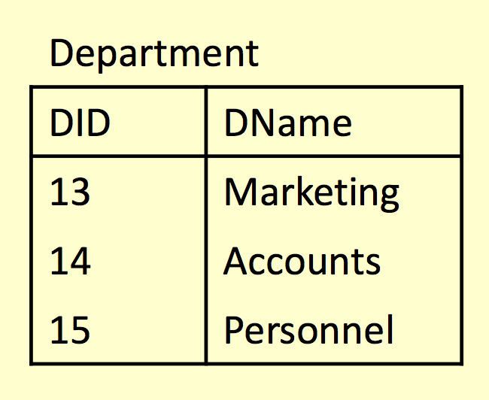
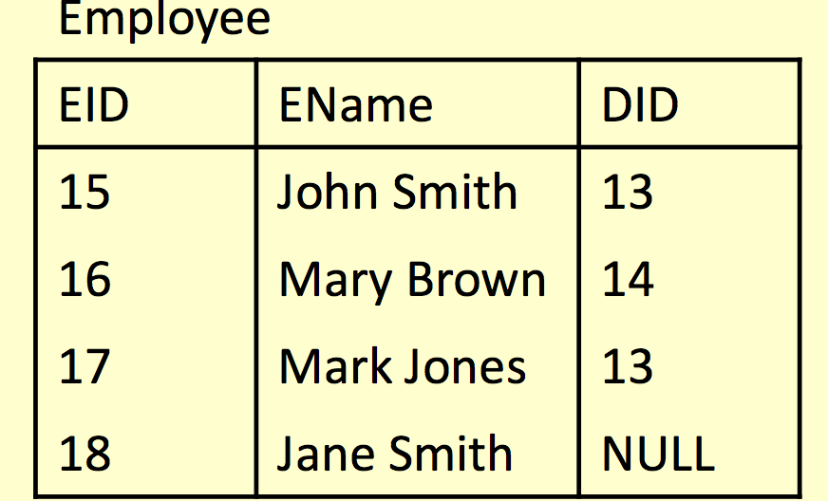
Referential Integrity Example
What happens if
• Marketing’s DID is changed to 16 in Department?
• The entry for Accounts is deleted from Department
Using RESTRICT, CASCADE and SET NULL

Slide 41
RESTRICT
What happens if
• Marketing’s DID is changed to 16 in Department?
• The entry for Accounts is deleted from Department

Slide 42
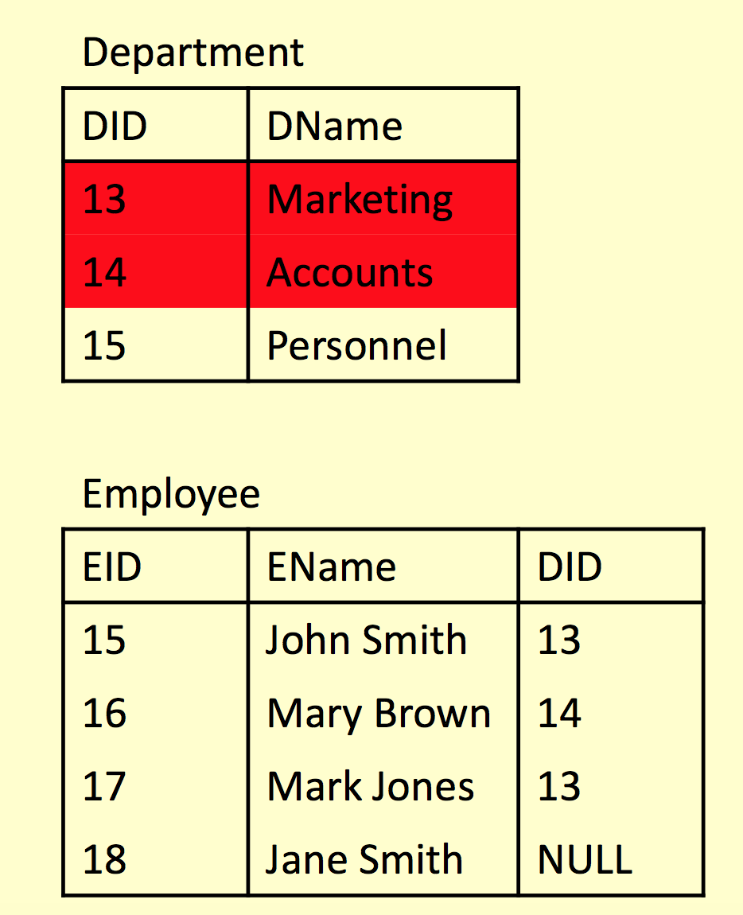
RESTRICT
• RESTRICT stops any action that violates integrity
You cannot update or delete Marketing or Accounts
You can change Personnel as it is not referenced

Slide 43
CASCADE
What happens if
• Marketing’s DID is changed to 16 in Department?
• The entry for Accounts is deleted from Department

Slide 44
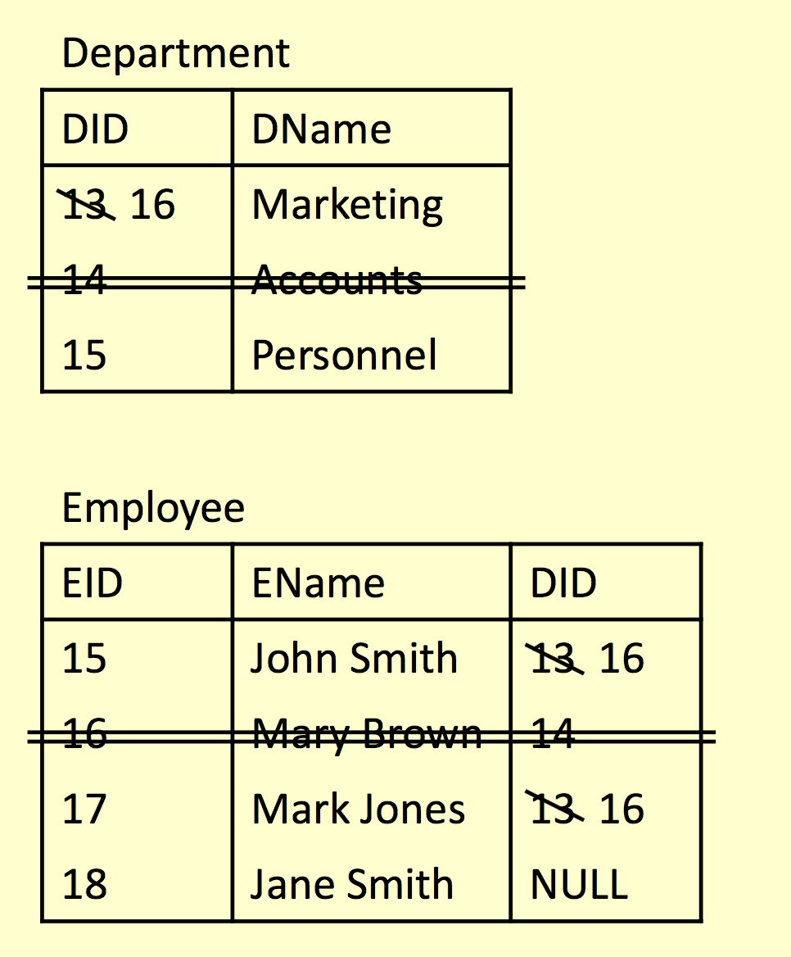
CASCADE
CASCADE allows the changes made to flow through
If Marketing’s DID is changed to 16 in Department, then the DIDs for John Smith and Mark Jones also change
If Accounts is deleted then so is Mary Brown

Slide 45
SET NULL
What happens if
• Marketing’s DID is changed to 16 in Department?
• The entry for Accounts is deleted from Department

Slide 46
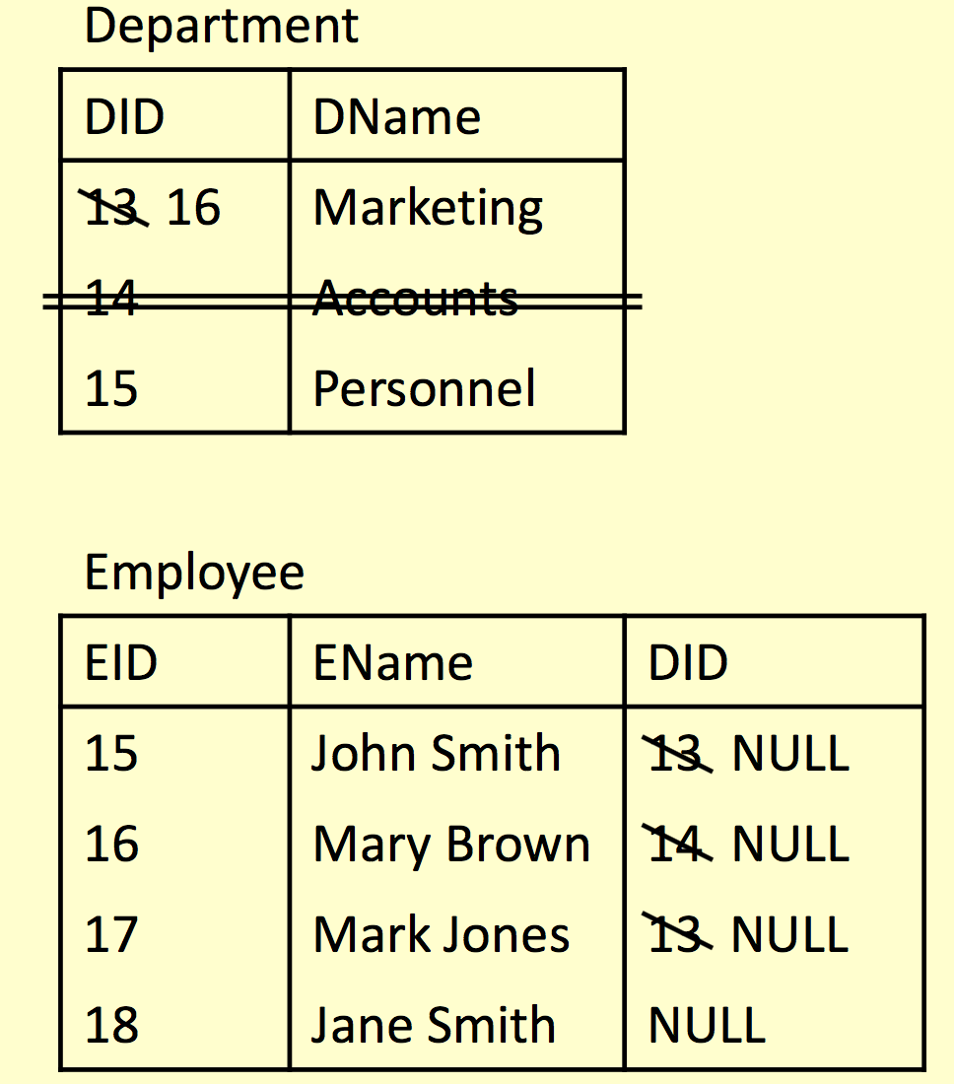
SET NULL
SET NULL allows the changes to happen but
If Marketing’s DID is changed to 16 in Department, then the DIDs for John Smith and Mark Jones is set to NULL
If Accounts is deleted then Mary Brown’s DID is set to NULL

Slide 47
Example
sName
sAddress
CREATE TABLE Enrolment (
sID INT NOT NULL,
mCode CHAR(6) NOT NULL,
sID
Student
sYear
... ADD PRIMARY KEY
... AND 2 FOREIGN KEYS
Has
);
sID
Enrolment
mCode
In
mCode
Module
mCredits
mTitle

Slide 48
Example
CREATE TABLE Enrolment (
sID INT NOT NULL,
mCode CHAR(6) NOT NULL,
CONSTRAINT en_pk
PRIMARY KEY (sID, mCode),
CONSTRAINT en_fk1 FOREIGN KEY (sID)
REFERENCES Student (sID) ON UPDATE CASCADE
ON DELETE CASCADE,
CONSTRAINT en_fk2 FOREIGN KEY (mCode)
REFERENCES Module (mCode) ON UPDATE CASCADE
sName
sAddress
sID
Student
sYear
Has
sID
Enrolment
mCode
In
mCode
Module
mCredits
ON DELETE NO ACTION
);
mTitle

Slide 49
Exercise
Create table in PostgreSQL from the E/R diagram on the right by identifying the:
price
destID
Destination
attractions
location
Name of the tables
The columns (inc. data types and attributes) for each table
Each table’s constraints
hotel
for
cliID
destID
Bookings
date
make
cliID
name
Clients
telephone
address

Slide 50
Solutions (1)
CREATE DATABASE
Holiday;
CREATE TABLE Clients(
cliID INT PRIMARY KEY
AUTO_INCREMENT,
cliName
varchar(255) NOT NULL,
cliAddress varchar(255),
cliTel INT
)
CREATE TABLE Destination(
destID INT PRIMARY KEY AUTO_INCREMENT,
destLocation VARCHAR(255),
destPrice destHotel
REAL, VARCHAR(255),
destAttractions
)
VARCHAR(255)

Slide 51
Solutions (2)
CREATE TABLE
Bookings(
cliID INT NOT
NULL,
destID INT
NOT NULL,
bookDate DATE,
CONSTRAINT CONSTRAINT REFERENCES
book_pk
book_fk1
PRIMARY
FOREIGN
KEY(cliID,destID),
KEY (cliID)
CASCADE,
KEY (destID)
Clients (cliID)
ON UPDATE CASCADE
ON DELETE
CONSTRAINT REFERENCES
book_fk2 FOREIGN
Destination
(destID)
ON UPDATE CASCADE
)
ON DELETE CASCADE

Slide 52
Deleting Tables
You can delete tables
with the DROP keyword
DROP TABLE
[IF EXISTS]
table-name;
Be extremely careful using any SQL statement with DROP in it.
  All rows in the table will also be deleted
  You won’t normally be
asked to confirm
  Undoing a DROP is difficult, sometimes impossible
For example:
DROP TABLE
Module;

Slide 53
Deleting Tables
You can delete multiple
tables in a list:
DROP TABLE
IF EXISTS
Module, Student;
Foreign Key constraints will prevent DROPS under the default RESTRICT option
  To overcome this, either remove the constraint or drop the tables in the correct order (referencing table first)
20

Slide 54
Changing Tables
Sometimes you want to change the structure of an existing table
  One way is to DROP it
then rebuild it
  This is dangerous, so there is the ALTER TABLE command instead
ALTER TABLE can
  Add a new column
  Remove an existing
column
  Add a new constraint
  Remove an existing
constraint
  Change column name and/or definition

Slide 55
Altering Columns
To add a column to a table:
For example:
ALTER TABLE Student ADD COLUMN sDegree VARCHAR(64) NOT NULL;
TABLE Student COLUMN sDegree;
ALTER TABLE ADD COLUMN
col-def
table-name col-name
OR
ALTER TABLE ADD COLUMN
table-name col-name
ALTER DROP
FIRST | AFTER col2
To remove a column from a table:
ALTER TABLE table-name DROP COLUMN col-name

Slide 56
Altering Columns
To change a column’s
name (and definition):
To change the definition
of a column only:
ALTER TABLE table-name rename column
col-name
To
new-colname
alter table table_name rename to new table_name ;
ALTER TABLE
table-name
ALTER COLUMN
col-name
TYPE
new-col-definition
alter table table_name alter column attr
type int using attr::int;
Note: Changing the type of a column might have unexpected results. Be careful that the type conversion taking place is appropriate.
E.g. INT → VARCHAR is ok, VARCHAR → INT is problematic.

Slide 57
Altering Columns - constraints
To remove a constraint:
ALTER TABLE table-name
...
To add a constraint:
ALTER TABLE table_name ADD FOREIGN KEY (column_name) REFERENCES table_name;

Slide 58
Altering Columns - constraints
To add a constraint:
ALTER TABLE table_name
DROP CONSTRAINT some_name;
To remove a constraint:
ALTER TABLE table-name DROP CONSTRAINT name

Slide 59
Altering Columns - constraints
To remove a constraint:
ALTER TABLE table-name
DROP CONSTRAINT name
That would be too easy!!
TABLE table-name INDEX name | FOREIGN KEY name | PRIMARY KEY
| means OR
To add a constraint:
ALTER TABLE table-name ADD CONSTRAINT
name
definition
For example:
ALTER TABLE Module ADD CONSTRAINT
ck_module UNIQUE
(mTitle);
ALTER
DROP DROP DROP

Slide 60
Example
CREATE TABLE Module ( mCode CHAR(6) NOT NULL,
mCredits TINYINT NOT NULL DEFAULT 10,
mTitle VARCHAR(100) NOT NULL
) ENGINE = InnoDB;
Module
What are the SQL command(s) to add a column lecID to the Module table? Followed by a foreign key constraint to reference the lecID column in a Lecturer table?
mCode | mCredits | mTitle
G64DBS | 10 | Database Systems
G51PRG | 20 | Programming
G51IAI | 10 | Artificial Intelligence
G52ADS | 10 | Algorithms

Slide 61
Example
To add a lecID column:
ALTER TABLE Module
ADD COLUMN lecID
INT NULL | NOT
NULL;
Module
mCode | mCredits | mTitle | lecID
G64DBS | 10 | Database Systems | NULL
G51PRG | 20 | Programming | NULL
G51IAI | 10 | Artificial Intelligence | NULL
G52ADS | 10 | Algorithms | NULL

Slide 62
Example
ALTER TABLE Module
ADD CONSTRAINT fk_mod_lec
FOREIGN KEY (lecID) REFERENCES
Module
To create a Foreign Key:
Lecturer
(lecID);
mCode | mCredits | mTitle | lecID
G64DBS | 10 | Database Systems | NULL
G51PRG | 20 | Programming | NULL
G51IAI | 10 | Artificial Intelligence | NULL
G52ADS | 10 | Algorithms | NULL

Slide 63
Example
Table Lecturer does NOT exist! So we need to create it first
CREATE TABLE Lecturer(
lecID INT PRIMARY KEY,
lecName VARCHAR(255) NOT NULL);
Then we can create the Foreign Key:
ALTER TABLE Module
ADD CONSTRAINT fk_mod_lec FOREIGN KEY (lecID) REFERENCES
Lecturer
(lecID);

Slide 64
INSERT, UPDATE, DELETE
INSERT - add a row to a table
UPDATE - change
row(s) in a table
DELETE - remove row(s) from a table
UPDATE and DELETE should make use of ‘WHERE clauses’ to
specify which rows to
change or remove
BE CAREFUL with these
- an incorrect or absent WHERE clause can destroy lots of data

Slide 65
INSERT
Inserts rows into the database with the specified values
INSERT INTO
table-name
The number of columns and the number of values must be the same
If you are adding a value to every column, you don’t have to list them
If you don’t list columns, be careful of the ordering
(col1, VALUES
(val1,
col2, …)
val2, …);

Slide 66
INSERT
INSERT INTO Employee (ID, Name, Salary) VALUES
(2, ‘Mary’, 26000);
Employee
INSERT INTO Employee (Name, ID)
VALUES (‘Mary’, 2);
INSERT INTO Employee VALUES
(2, ‘Mary’, 26000);
ID | Name | Salary
1 | John | 25000

Slide 67
INSERT
Employee
INSERT INTO Employee (ID, Name, Salary) VALUES
(2, ‘Mary’, 26000);
ID | Name | Salary
1 | John | 25000
2 | Mary | 26000
Employee
Employee
ID | Name | Salary
1 | John | 25000
INSERT INTO Employee (Name, ID)
VALUES (‘Mary’, 2);
ID | Name | Salary
1 | John | 25000
2 | Mary
INSERT INTO Employee VALUES
(2, ‘Mary’, 26000);
Employee
ID | Name | Salary
1 | John | 25000
2 | Mary | 26000

Slide 68
Example
CREATE
TABLE Student (
sID INT
AUTO_INCREMENT
PRIMARY
KEY,
sName
VARCHAR(50) NOT
NULL,
sAddress
VARCHAR(255),
sYear INT DEFAULT 1
);

Slide 69
INSERT
INSERT INTO Student
(sID, sName, sAddress, sYear) VALUES
(1, ‘Smith’, ‘5 Arnold Close’, 1);
INSERT INTO Student (sName, sAddress, sYear) VALUES
(‘Smith’, NULL, 2);
INSERT INTO Student
(sName, sAddress) VALUES
(‘Smith’, ‘5 Arnold Close’),
(‘Brooks’, ‘7 Holly Ave.’);

Slide 70
INSERT
INSERT INTO Student
(sID, sName, sAddress, sYear) VALUES
(1, ‘Smith’, ‘5 Arnold Close’, 1);
Student
sID | sName | sAddress | sYear
1 | Smith | 5 Arnold Close | 1
Student
INSERT INTO Student (sName, sAddress, sYear) VALUES
(‘Smith’, NULL, 2);
sID | sName | sAddress | sYear
1 | Smith | NULL | 2
Student
INSERT INTO Student
(sName, sAddress) VALUES
(‘Smith’, ‘5 Arnold Close’),
(‘Brooks’, ‘7 Holly Ave.’);
sID | sName | sAddress | sYear
1 | Smith | 5 Arnold Close | 1
2 | Brooks | 7 Holly Ave. | 1

Slide 71
UPDATE
Changes values in specified rows based on WHERE conditions
All rows where the condition is true have the columns set to the given values
If no condition is given all rows are changed so BE CAREFUL
Values are constants or can be computed from columns
UPDATE
table-name
SET col1 [,col2
[WHERE
= val1
= val2…]
condition]

Slide 72
UPDATE
UPDATE Employee
SET Salary
Name =
WHERE ID =
= 15000,
‘Jane’
4
Employee
ID | Name | Salary
1 | John | 25000
2 | Mary | 26000
3 | Mark | 18000
4 | Anne | 22000
UPDATE Employee SET Salary =
Salary *
1.05

Slide 73
UPDATE
UPDATE Employee
SET Salary
Name =
WHERE ID =
= 15000,
‘Jane’
4;
Employee
ID | Name | Salary
1 | John | 25000
2 | Mary | 26000
3 | Mark | 18000
4 | Anne | 22000
UPDATE Employee SET Salary =
Salary *
1.05;

Slide 74
UPDATE
Employee
ID | Name | Salary
1 | John | 25000
2 | Mary | 26000
3 | Mark | 18000
4 | Jane | 15000
UPDATE Employee
SET Salary
Name =
WHERE ID =
= 15000,
‘Jane’
4;
Employee
ID | Name | Salary
1 | John | 25000
2 | Mary | 26000
3 | Mark | 18000
4 | Anne | 22000
Employee
ID | Name | Salary
1 | John | 26250
2 | Mary | 27300
3 | Mark | 18900
4 | Anne | 23100
UPDATE Employee SET Salary =
Salary *
1.05;

Slide 75
DELETE
Removes all rows, or those
which satisfy a condition
DELETE FROM
table-name [WHERE
condition]
If no condition is given then ALL rows are deleted - BE CAREFUL
You might also use TRUNCATE TABLE which is like DELETE FROM without a WHERE but is often quicker

Slide 76
DELETE
DELETE FROM
Employee
WHERE
Salary > 20000;
Employee
ID | Name | Salary
1 | John | 25000
2 | Mary | 26000
3 | Mark | 18000
4 | Jane | 15000
DELETE FROM Employee;
Or
TRUNCATE TABLE
Employee;

Slide 77
DELETE
Employee
ID | Name | Salary
3 | Mark | 18000
4 | Jane | 15000
DELETE FROM
Employee
WHERE
Salary > 20000;
Employee
ID | Name | Salary
1 | John | 25000
2 | Mary | 26000
3 | Mark | 18000
4 | Jane | 15000
DELETE FROM Employee;
Or
TRUNCATE TABLE
Employee;
Employee
ID | Name | Salary

Slide 78
SQL SELECT
SELECT is the type of query you will use most
often.
  Queries one or more tables and returns the result as a table
  Lots of options, which will be covered over the
next few lectures
  Usually queries can be achieved in a number of ways

Slide 79
Simple SELECT
columns can be
A single column
A comma-separated list
of columns
* for ‘all columns’
SELECT
FROM
columns
table-name;

Slide 80
Sample SELECTs
SELECT
* FROM
Student;
Student
sID | sName | sAddress | sYear
1 | Smith | 5 Arnold Close | 2
2 | Brooks | 7 Holly Avenue | 2
3 | Anderson | 15 Main Street | 3
4 | Evans | Flat 1a, High Street | 2
5 | Harrison | Newark Hall | 1
6 | Jones | Southwell Hall | 1

Slide 81
Sample SELECTs
SELECT
sName
FROM
Student;

Slide 82
Sample SELECTs
SELECT
sName
FROM
Student;
sName
Smith
Brooks
Anderson
Evans
Harrison
Jones

Slide 83
Sample SELECTs
SELECT
FROM
sName, sAddress
Student;

Slide 84
Sample SELECTs
SELECT
FROM
sName, sAddress
Student;
sName | sAddress
Smith | 5 Arnold Close
Brooks | 7 Holly Avenue
Anderson | 15 Main Street
Evans | Flat 1a, High Street
Harrison | Newark Hall
Jones | Southwell Hall

